Slide 1
Employee Data Analysis using Excel
STUDENT NAME: PRINCY .S
REGISTER NO: 422200902
DEPARTMENT: B.COM ISM
COLLEGE: SHRI KRISHNASWAMY COLLEGE FOR WOMEN

Slide 2
PROJECT TITLE
TURNOVER ANALYSIS

Slide 3


AGENDA
Problem Statement
Project Overview
End Users
Our Solution and Proposition
Dataset Description
Modelling Approach
Results and Discussion
Conclusion
3/21/2024 Annual Review

Slide 4

PROBLEM STATEMENT
Problem: The organization is experiencing a high employee turnover rate, which is impacting operational efficiency, increasing recruitment and training costs, and affecting overall team morale.
Context: Over the past year, the turnover rate has risen significantly, with several key positions becoming vacant frequently. Exit interviews and employee feedback suggest that dissatisfaction with management, inadequate career development opportunities, and competitive salary offers from other companies are major contributing factors. The high turnover is leading to disruptions in workflow and loss of institutional knowledge.
Objectives: To understand the underlying causes of the high turnover rate and develop actionable strategies to reduce it. This involves analyzing turnover data, identifying patterns and key factors contributing to employee exits, and implementing targeted initiatives to improve employee retention.
Scope: The analysis will focus on turnover data from the past year, including reasons for departure, employee demographics, tenure, and department-specific trends. The study will not address broader organizational issues unrelated to turnover, such as overall financial performance or market conditions
“

Slide 5

PROJECT OVERVIEW
1. Project Title: Turnover Analysis and Retention Strategy Development
2. Project Objective: To analyze employee turnover data to identify underlying causes and trends, and to develop targeted strategies to improve employee retention and reduce turnover rates within the organization.
3. Background: The organization has been facing a significant increase in employee turnover over the past year. High turnover rates are leading to increased recruitment and training costs, loss of experienced personnel, and disruptions in team productivity.
4. Budget: Outline the budget required for data collection, analysis tools, implementation of strategies, and any external consulting or training needed.
5. Risks and Mitigation:
Data Accuracy: Ensure data integrity by validating sources and methods.
Resistance to Change: Address potential resistance through communication and involvement of employees in the process.
Resource Constraints: Allocate resources efficiently and prioritize high-impact strategies.
This overview provides a structured approach to analyzing turnover and developing effective strategies to improve employee retention.

Slide 6

WHO ARE THE END USERS?
1. Human Resources (HR) Team
2. Management and Leadership
3. Employees
4. Recruitment and Talent Acquisition Teams
5. Finance and Budgeting Teams
6. External Consultants or Advisors (if applicable)
Use: The consultants will use the data to offer tailored advice and strategies based on industry best practices and specific organizational needs.
By understanding the needs and roles of these end users, the turnover analysis can be tailored to provide actionable insights and recommendations that address their specific concerns and goals.

Slide 7

OUR SOLUTION AND ITS VALUE PROPOSITION
Solution Overview: Our turnover analysis involves a comprehensive evaluation of employee departure data to uncover key drivers of turnover and develop effective strategies for improving retention. The solution combines data-driven insights with practical recommendations tailored to the organization's unique needs, ensuring a targeted approach to reducing turnover rates and enhancing employee satisfaction.
This solution provides a structured approach to understanding and addressing turnover, offering tangible benefits that enhance both employee satisfaction and organizational performance.

Slide 8
Dataset Description
A well-structured dataset is crucial for effective turnover analysis. Here’s a description of the key components and attributes that should be included in the turnover analysis dataset:
1. Employee Information
Employee ID: Unique identifier for each employee.
Name: Employee’s full name (optional, for internal use).
Department: The department in which the employee worked.
Job Title: Employee’s job role or position.
Hire Date: The date when the employee joined the organization.
Termination Date: The date when the employee left the organization.
Tenure: The length of time the employee stayed with the organization (calculated from Hire Date to Termination Date).
This dataset provides a comprehensive view of employee turnover, capturing both quantitative and qualitative aspects. It allows for detailed analysis of turnover trends and factors, facilitating the development of targeted retention strategies.

Slide 9

THE "WOW" IN OUR SOLUTION
Real-Time Monitoring and Feedback
What: We offer real-time monitoring of turnover metrics and feedback loops to continuously assess the effectiveness of implemented strategies.
Wow: This dynamic approach ensures that strategies can be adjusted promptly based on the latest data, maintaining alignment with organizational goals and employee needs.
3/21/2024 Annual Review
9

Slide 10
MODELLING
. Model Selection:
Logistic Regression: For predicting the likelihood of an employee leaving based on various factors.
Decision Trees/Random Forests: To classify employees into categories (e.g., likely to leave vs. likely to stay) based on multiple features.
Survival Analysis: To model the time until an employee leaves, incorporating the duration of employment.
3.2. Model Training:
Feature Selection: Choose the most relevant variables that influence turnover.
Cross-Validation: Use techniques like k-fold cross-validation to validate model performance and avoid overfitting.
3.3. Model Evaluation:
Accuracy Metrics: Evaluate model performance using metrics such as accuracy, precision, recall, F1 score, and AUC-ROC curve.
Confusion Matrix: Analyze false positives and false negatives to understand model strengths and weaknesses.
3.4. Model Deployment:
Integration: Implement the model in HR systems to flag high-risk employees and predict potential turnover.
Real-Time Monitoring: Continuously monitor the model’s performance and update it with new data.
10

Slide 11
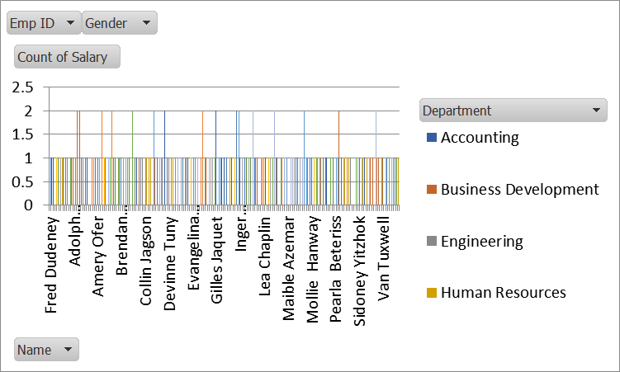
RESULTS
11

Slide 12
conclusion
The turnover analysis has provided valuable insights into the underlying causes of employee departures and highlighted areas where strategic improvements can be made. By addressing the identified issues and implementing the recommended strategies, the organization can reduce turnover rates, enhance employee satisfaction, and improve overall operational efficiency. Ongoing monitoring and a commitment to continuous improvement will be crucial in achieving and maintaining a stable and engaged workforce.
This conclusion ensures that the findings are actionable, aligned with organizational goals, and provides a clear path forward for addressing turnover challenges.
Follow-Up:
Review Schedule: Set a schedule for reviewing the impact of implemented strategies and revisiting turnover data to ensure that improvements are achieved.
Feedback Mechanism: Establish a system for gathering ongoing feedback from employees to continuously refine and improve retention efforts.

